Slide 1



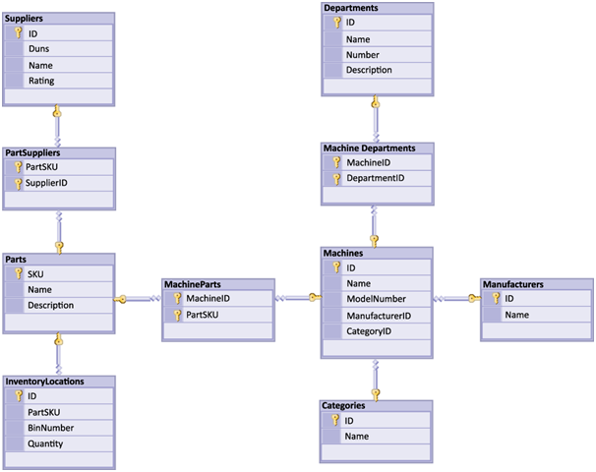


Data Modeling
Creating E/R Diagrams
SoftUni Team
Technical Trainers
Software University
http://softuni.bg

Slide 2


Table of Contents
Data Modeling – Principles
Data Types in SQL Server
Creating Databases in SQL Server
Creating Tables
Defining a Primary Key and Identity Columns
Creating Relationships between the Tables
One-to-many, Many-to-many, One-to-one
Naming Conventions
Data Modeling in MySQL Workbench

Slide 3
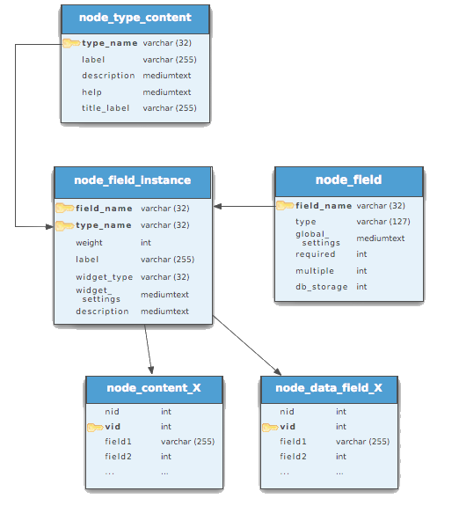


Relational Data Modeling
Fundamental Concepts

Slide 4

Steps in Database Design
Steps in the database design process:
Identification of the entities
Identification of the columns in the tables
Defining a primary key for each entity table
Identification and modeling of relationships
Multiplicity of relationships
Defining other constraints
Filling test data in the tables

Slide 5
Identification of Entities
Entity tables represent objects from the real world
Most often they are nouns in the specification
For example:
Entities: Student, Course, Town
We need to develop a system that stores information about students, which are trained in various courses. The courses are held in different towns. When registering a new student the following information is entered: name, faculty number, photo and date.

Slide 6
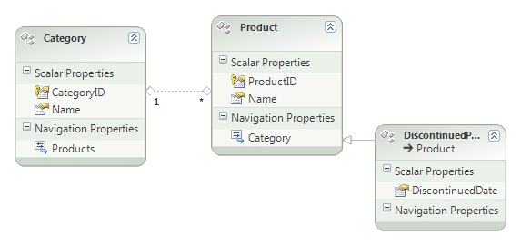

Identification of Columns
Columns in the tables are characteristics of the entities
They have name and type
For example students have:
Name (text)
Faculty number (number)
Photo (binary block)
Date of enlistment (date)

Slide 7
Identification of the Columns
Columns are clarifications for the entities in the text of the specification, for example:
Students have the following characteristics:
Name, faculty number, photo, date of enlistment and a list of courses they visit
We need to develop a system that stores information about students, which are trained in various courses. The courses are held in different towns. When registering a new student the following information is entered: name, faculty number, photo and date.

Slide 8
How to Choose a Primary Key?
Always define an additional column for the primary key
Don't use an existing column (for example SSN)
Must be an integer number
Must be declared as a primary key
Use identity to implement auto-increment
Put the primary key as a first column
Exceptions
Entities that have well known ID, e.g. countries (BG, DE, US) and currencies (USD, EUR, BGN)

Slide 9
Identification of Relationships
Relationships are dependencies between the entities:
"Students are trained in courses" – many-to-many relationship
"Courses are held in towns" – many-to-one (or many-to-many) relationship
We need to develop a system that stores information about students, which are trained in various courses. The courses are held in different towns. When registering a new student the following information is entered: name, faculty number, photo and date.

Slide 10
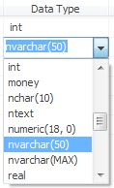

Data Types in SQL Server 2012

Slide 11
Data Types in SQL Server
Numeric
bit (1-bit), integer (32-bit), bigint (64-bit)
float, real, numeric(scale, precision)
money – for money (precise) operations
Strings
char(size) – fixed size string
varchar(size) – variable size string
nvarchar(size) – Unicode variable size string
text / ntext – text data block (unlimited size)

Slide 12
Data Types in SQL Server (2)
Binary data
varbinary(size) – a sequence of bits
image – a binary block up to 1 GB
Date and time
datetime – date and time starting from 1.1.1753 to 31.12. 9999, a precision of 1/300 sec.
smalldatetime – date and time (1-minute precision)

Slide 13

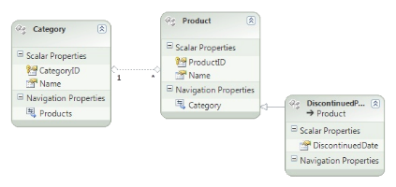
Data Types in SQL Server (3)
Other types
timestamp – automatically generated number whenever a change is made to the data row
uniqueidentifier – GUID identifier
xml – data in XML format

Slide 14


Data Types in SQL Server (4)
Nullable and NOT NULL types
All types in SQL Server may or may not allow NULL values
Primary key columns
Define the primary key
Identity columns
Automatically increased values when a new row is inserted (auto-increment values)
Used in combination with primary key

Slide 15

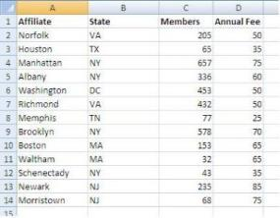



Database Modeling with SQL Server Management Studio
Creating Database

Slide 16
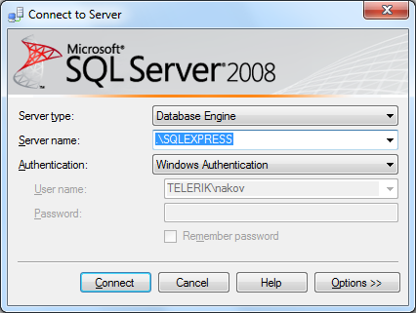
Connecting to SQL Server
When starting SSMS a window pops up
Usually it is enough to just click the "Connect" button without changing anything

Slide 17
Working with Object Explorer
Object Explorer is the main tool to use when working with the database and its objects
Enables us:
To create a new database
To create objects in the database (tables, stored procedures, relationships and others)
To change the properties of objects
To enter records into the tables

Slide 18
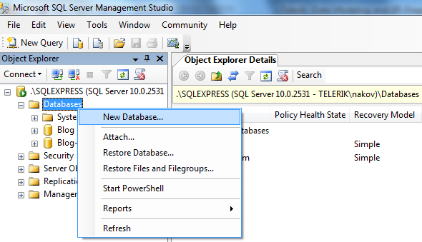
Creating a New Database
In Object Explorer we go to the "Databases" and choose "New Database…" from the context menu

Slide 19
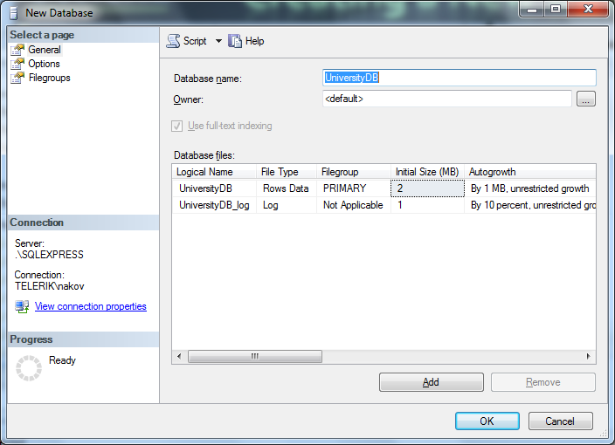
Creating a New Database (2)
In the "New Database" window enter the name of the new database and click [OK]

Slide 20
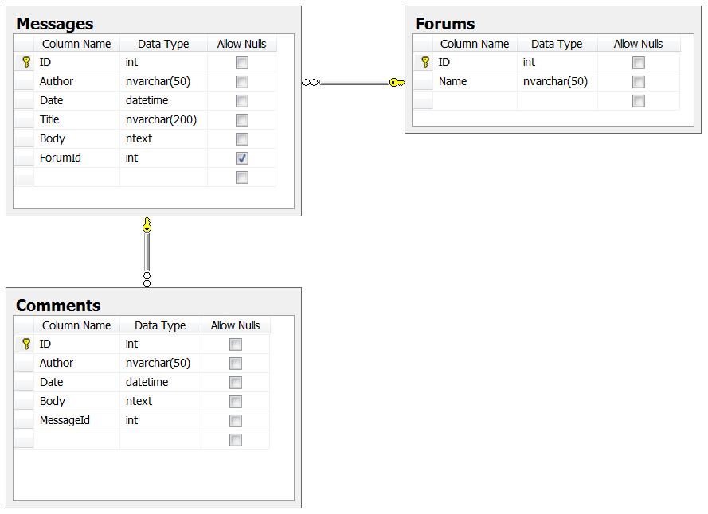

Database Modeling with SQL Server Management Studio
Creating E/R Diagrams

Slide 21
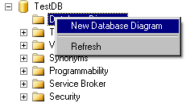
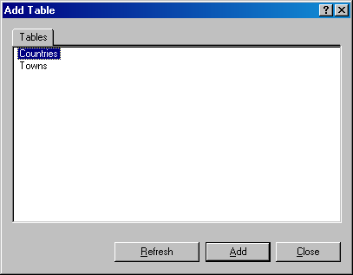
Creating an E/R diagram
In the "Database Diagrams" menu choose the "New Database Diagram"
We can choose from the existing tables, which we want to add to the diagram

Slide 22

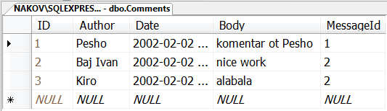

Database Modeling with SQL Server Management Studio
Creating Tables

Slide 23
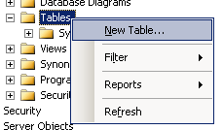
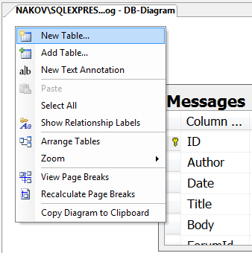
Creating Tables
If the database doesn't show immediately in Object Explorer perform "Refresh" [F5]
Creating new table:

Slide 24
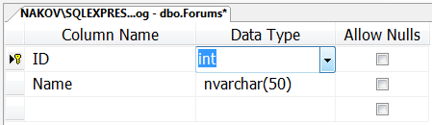
Creating Tables (2)
Enter table name and define the table columns (name and type):
Enter the name of the column here
Choose the data type of the column here
Choose whether NULLs are allowed

Slide 25
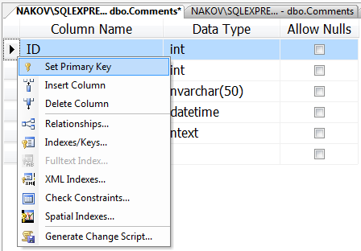
Creating Tables (3)
Defining a primary key
Right click on the column start and select "Set Primary Key"

Slide 26
Creating Tables (4)
Defining an identity columns
Identity means that the values in a certain column are auto generated (for int columns)
These values cannot be assigned manually
Identity Seed – the starting number from which the values in the column begin to increase.
Identity Increment – by how much each consecutive value is increased

Slide 27
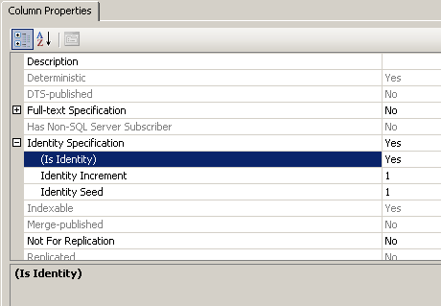
Creating Tables (5)
Setting an identity through the "Column Properties" window

Slide 28
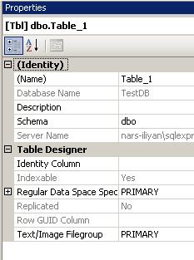
Creating Tables (6)
It is a good practice to set the name of the table at the time it is created
Use the "Properties" window
If it's not visible use "View" → "Properties Window" or press [F4]
Tablename

Slide 29
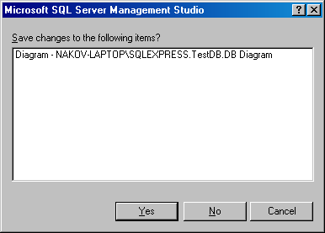
Creating Tables (7)
When closing the window for the table, SSMS asks whether to save the table
You can do it manually by choosing “Save Table” from the “File” menu or by pressing Ctrl + S

Slide 30



Database Modeling with SQL Server Management Studio
Creating Relationships between Tables

Slide 31
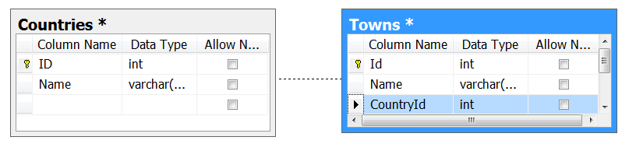
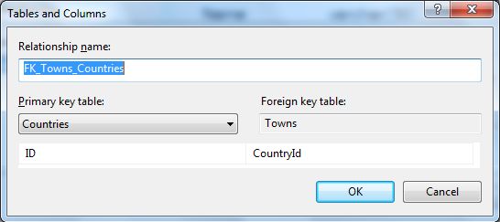
Creating Relationships
To create one-to-many relationship drag the foreign key column onto the other table
Drag from the child table to the parent table

Slide 32
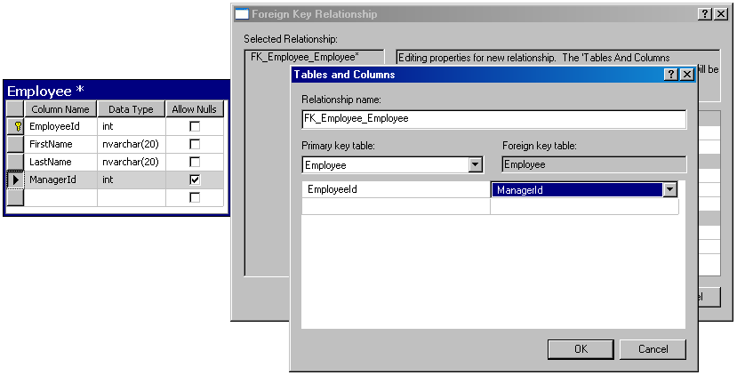
Self-Relationships
Self-relationship can be created by dragging a foreign key onto the same table

Slide 33



Database Modeling with SQL Server Management Studio
Naming Conventions

Slide 34
Naming Conventions
Tables
Each word is capitalized (Pascal Case)
In English, plural
Examples: Users, PhotoAlbums, Countries
Columns
In English, singular
Each word is capitalized (Pascal Case)
Avoid reserved words (e.g. key, int, date)
Examples: FirstName, OrderDate, Price

Slide 35
Naming Conventions (2)
Primary key
Use "Id" or name_of_the_table + "Id"
Example: in the Users table the PK column should be be called Id or UserId
Foreign key
Use the name of the referenced table + "Id"
Example: in the Users table the foreign key column that references the Groups table should be named GroupId

Slide 36
Naming Conventions (3)
Relationship names (constraints)
In English, Pascal Case
"FK_" + table1 + "_" + table2
For example: FK_Users_Groups
Index names
"IX_" + table + column
For example: IX_Users_UserName

Slide 37
Naming Conventions (4)
Unique key constraints names
"UK_" + table + column
For instance: UK_Users_UserName
Views names
V_ + name
Example: V_BGCompanies
Stored procedures names
usp_ + name
Example: usp_InsertCustomer(@name)

Slide 38

Database Modeling with SQL Server Management Studio
Live Demo

Slide 39
Database Modeling with MySQL
Naming Conventions

Slide 40
MySQL Naming Conventions
Tables
Each word is lowercase
Underscore as delimiter
Examples: students, security_user_persmissions
Columns
In English, singular
Each word is lowercase
Examples: first_name, birth, submission

Slide 41
MySQL Naming Conventions (2)
Primary Key
Use "id" or name_of_the_table + "_id"
Example: in the users table the PK column should be be called id or user_id
Foreign Key
Use the name of the referenced table + "_id"
Example: in the users table the foreign key column that references the groups table should be named group_id

Slide 42
MySQL Naming Conventions (3)
Relationship names (constraints)
Example: "fk_" + table1 + "_" + table2
Index names
Example: "ix_" + full_name
Unique key names
Example: "fk_" + username
Views names
Example: "v_" + viewname
Stored procedures names
Example: "usp_" + procedurename

Slide 43
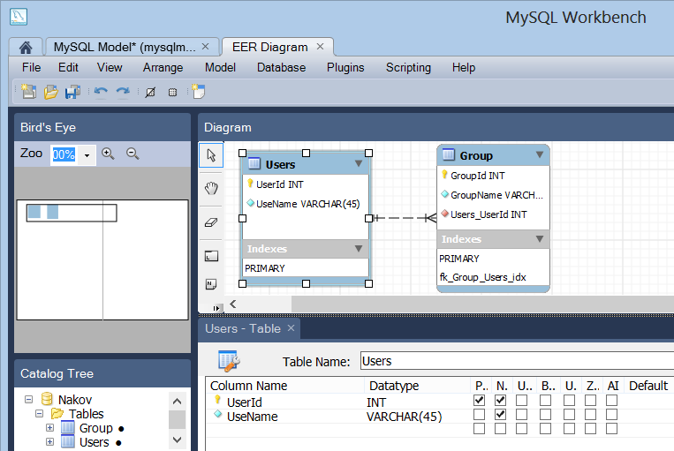
Data Modeling in MySQL
Creating E/R Diagrams with MySQL Workbench

Slide 44
E/R Diagrams in MySQL Workbench
MySQL Workbench supports database schema design (E/R diagrams)
Can reverse engineer an existing database
Can forward engineer the diagram into SQL script / existing / new database
Can synchronize schema changes with existing database
User-unfriendly UI but better than nothing
Edit tables, relationships, indices, triggers, …

Slide 45
Data Modeling in MySQL
Live Demo

Slide 46


Summary
Data Modeling – Principles
Data Types in SQL Server
Creating Databases in SQL Server
Creating Tables
Defining a Primary Key and Identity Columns
Creating Relationships between the Tables
One-to-many, Many-to-many, One-to-one
Naming Conventions
Data Modeling in MySQL Workbench
Databases

Slide 47







Databases
https://softuni.bg/courses/databases

Slide 48
License
This course (slides, examples, demos, videos, homework, etc.) is licensed under the "Creative Commons Attribution-NonCommercial-ShareAlike 4.0 International" license
Attribution: this work may contain portions from
"Databases" course by Telerik Academy under CC-BY-NC-SA license

Slide 49





Free Trainings @ Software University
Software University Foundation – softuni.org
Software University – High-Quality Education, Profession and Job for Software Developers
softuni.bg
Software University @ Facebook
facebook.com/SoftwareUniversity
Software University @ YouTube
youtube.com/SoftwareUniversity
Software University Forums – forum.softuni.bg

